Slide 1





Project 1 The World Happiness
By Soukhna Wade
Bellevue DSC680
Applied Data Science

Slide 2
Data Sources: World Happiness Report 2017
Country: Name of countries
Happiness Rank: Rank of the country based on the Happiness Score
Happiness Score: Happiness measurement on a scale of 0 to 10
Economy: Value of all final goods and services produced within a nation each
Family: Importance of having a family
Life Expectancy: Importance of health and amount of time people expect to live
Freedom: Importance of freedom in each country
Generosity: The quality of being kind and generous
Trust: Perception of corruption in a government
Dystopia Residual: Plays as a reference
Continents

Slide 3
Cleaning Dataset
Data cleaning is the process of detecting and correcting corrupt or inaccurate records from a record set, table, or database and refers to identifying incomplete, incorrect, inaccurate, or irrelevant parts of the data and then replacing, modifying, or deleting the dirty or coarse data.

Slide 4
Visualization
visualization's purpose is the communication of data. Visualization transforms from the invisible to the visible. In this section, we use different variables to determine their correlation
Notes:
visualization's purpose is the communication of data. Visualization transforms from the invisible to the visible. In this section, we use different variables to determine their correlation
Data cleansing may be performed interactively with data wrangling tools, or as batch processing through scripting. First, I load my dataset using Pandas to check for missing or null values. For instance, you can find in the below line that the dataset is cleaned. So, there is no need to clean it again. In the following example I used Pandas to determine if there are any missing values in the

Slide 5
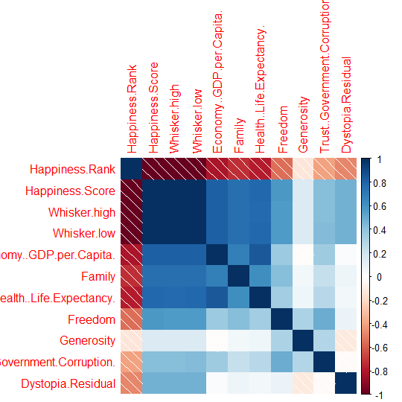
Correlation plot between numerical variables
There is an inverse correlation between the Happiness Rank and all the other numerical variables. The lower the happiness rank, the higher the happiness score, and the higher the other seven factors that contribute to happiness.

Slide 6
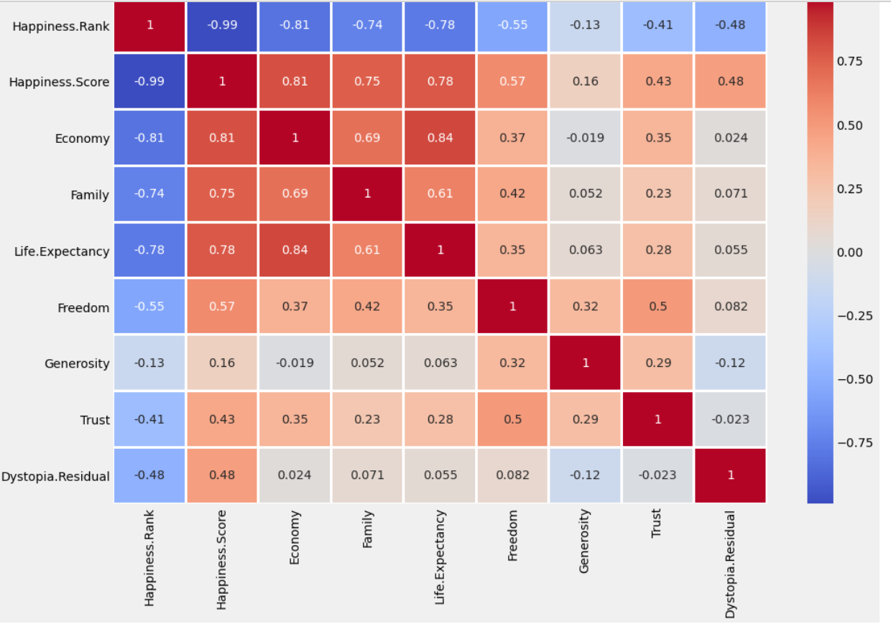
Heatmap
The heatmap of correlation among the variables displays the color palette in the side represents the amount of correlation among the variables. Therefore, the lighter shade represents a high correlation. You can see that the happiness score correlated with the economy, family, and life expectancy. It is least correlated with generosity

Slide 7
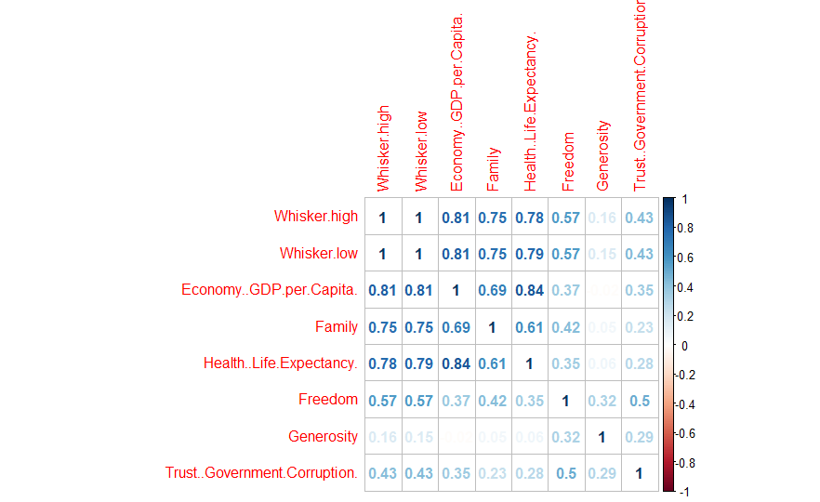
Removing happiness Rank
The correlation plot shows that the economy, life expectancy, and family play the most significant role in contributing to happiness. Trust and generosity have the lowest impact on happiness scores.

Slide 8
Prediction
We implement several machine learning algorithms to predict happiness scores. First, we split our dataset into training and test set. The dependent variable is happiness score, and the independent variables are economy, family, life expectancy, freedom, generosity, trust, and dystopia residual.

Slide 9
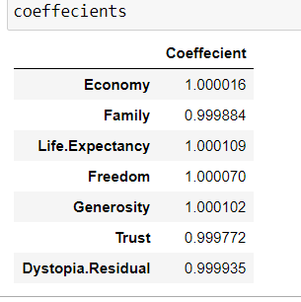
Coefficients
Notes:
The above result shows that there is a positive correlation. This indicates that when the predictor variable increases, the response variable will also increase.

Slide 10
Conclusion
The summary shows that all independent variables have a significant impact, and the adjusted R squared is one. There is a linear correlation between dependent and independent variables. Also, the sum of the independent variables is equal to the dependent variable which is the happiness score. This is the justification for having an adjusted R squared equal to one. As a result, multiple Linear Regression will predict happiness scores with 100 % accuracy.

Slide 11
References
1. https://worldhappiness.report/archive/
2. https://www.kaggle.com/unsdsn/world-happiness
3. https://www.kaggle.com/pinarkaya/world-happiness-eda-visualization-ml/data#Linear-Regression
4. https://www.kaggle.com/javadzabihi/happiness-2017-visualization-prediction/report
5. https://www.kaggle.com/roshansharma/world-happiness-report?select=2017.csv
6. https://www.kaggle.com/pinarkaya/world-happiness-eda-visualization-ml#Random-Forest
7. https://www.kaggle.com/dhanyajothimani/basic-visualization-and-clustering-in-python/data
8. https://towardsdatascience.com/understanding-random-forest-58381e0602d2
9. https://en.wikipedia.org/wiki/The_Happiness_Hypothesis
10. https://www.theworldcounts.com/happiness/the-definition-of-happiness-in-psychology
11. Statistical Appendix for Chapter 2 of the World Happiness Report 2020 John F. Helliwell, Haiyang Huang, Shun Wang, and Max Norton February 29, 2020

